Slide 1

Verification
Dr Stephen Hamil - Director of Design and Innovation

Slide 2
Introduction
Information Production
Handover

Slide 3
a. Information Production

Slide 4
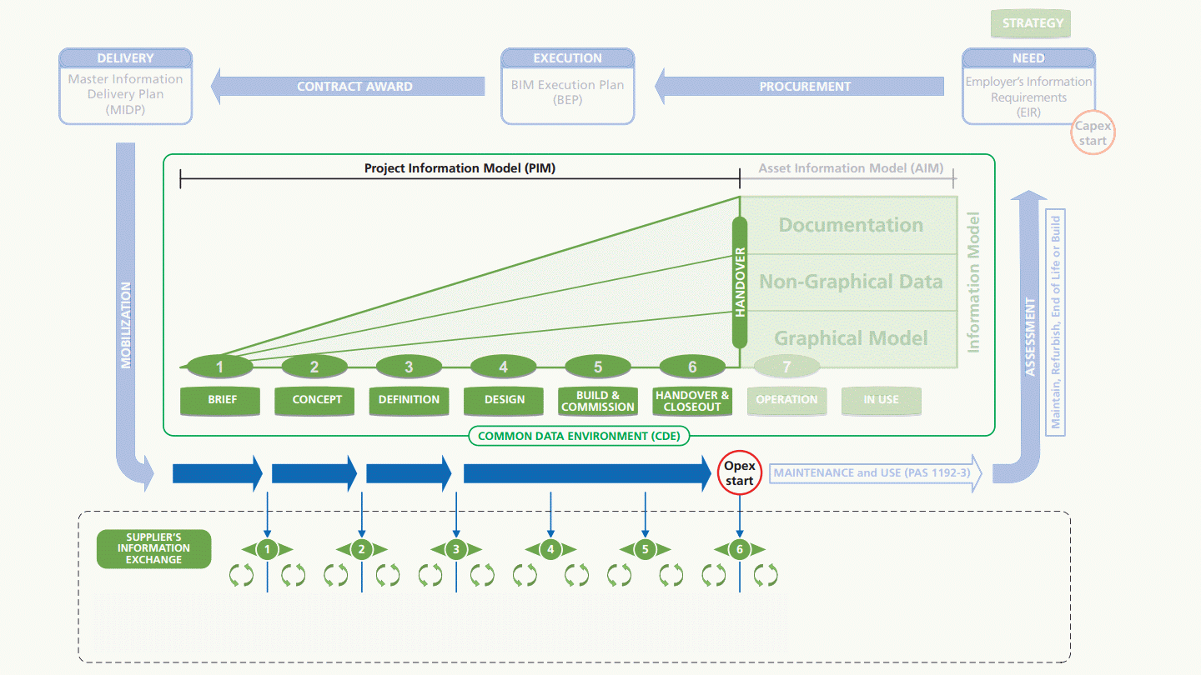



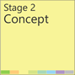




Production
Notes:
Now the production stage begins, concept, developed, technical design and the construction and then hand-over

Slide 5
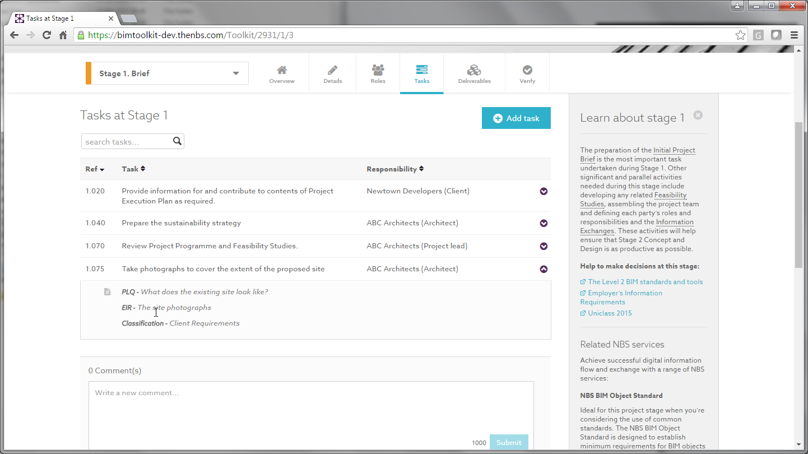
Each task has a specific EIR
Notes:
Now the production stage begins, concept, developed, technical design and the construction and then hand-over

Slide 6
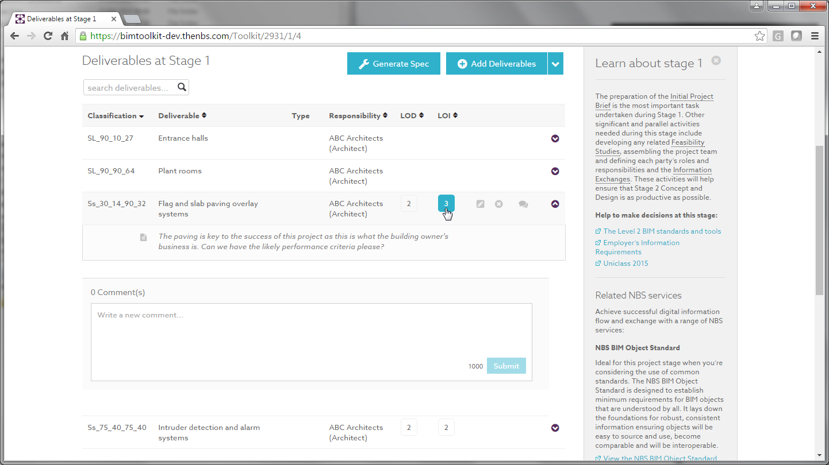
Modelled items may also be included in the deliverables list
Notes:
Now the production stage begins, concept, developed, technical design and the construction and then hand-over

Slide 7
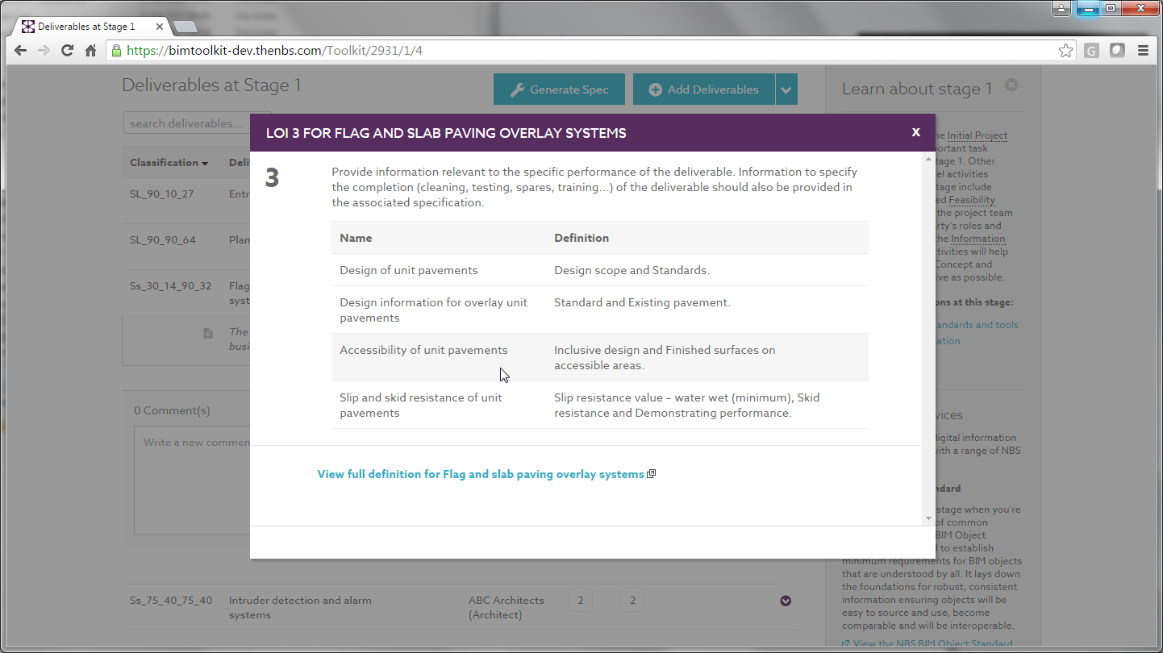
Pre-defined properties for each LOI banding
Notes:
Now the production stage begins, concept, developed, technical design and the construction and then hand-over

Slide 8
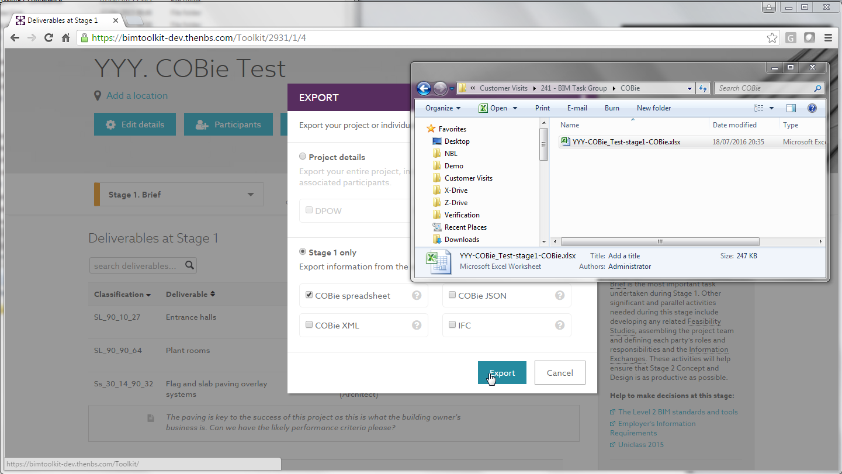
A COBie file for the required information is produced
Notes:
Now the production stage begins, concept, developed, technical design and the construction and then hand-over

Slide 9
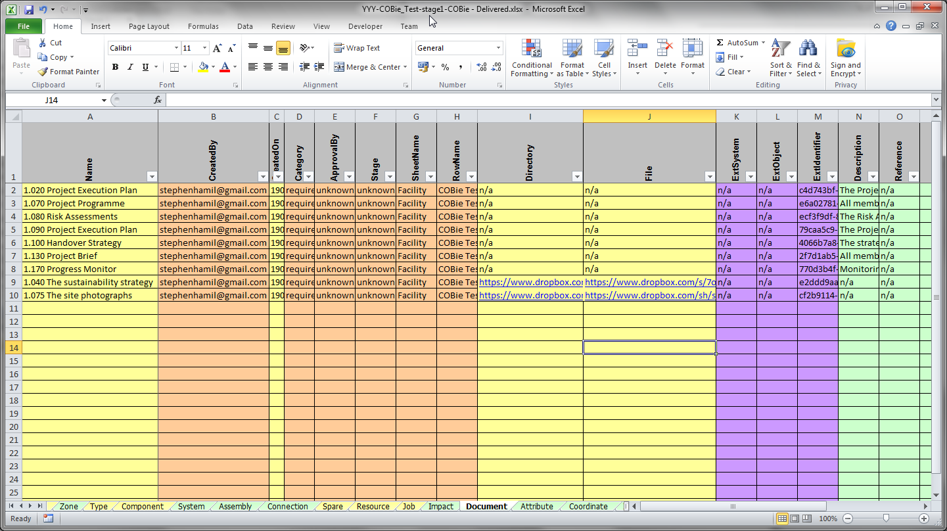
The supplier fills in the blank cells in the spreadsheet
Notes:
Now the production stage begins, concept, developed, technical design and the construction and then hand-over

Slide 10
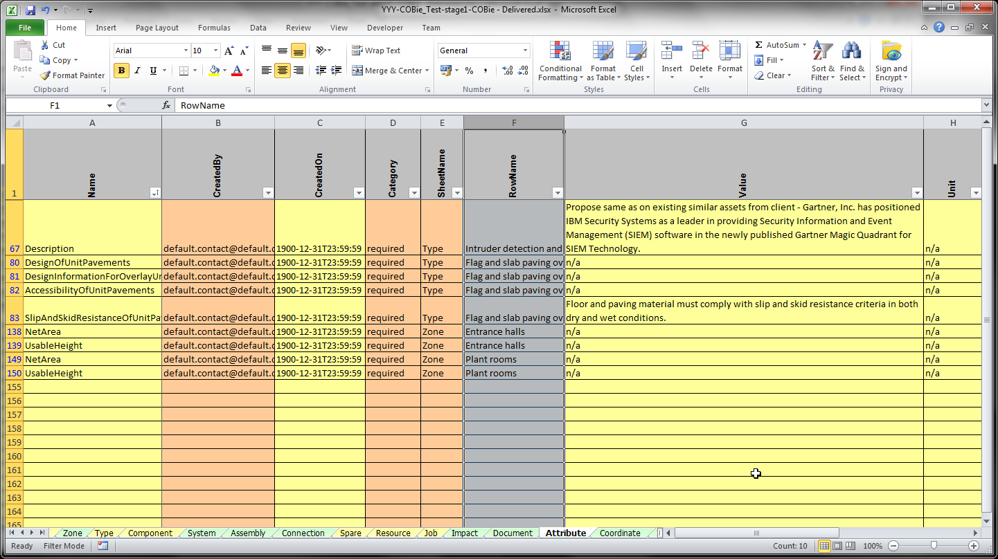
Information can be added to the Attributes tab
Notes:
Now the production stage begins, concept, developed, technical design and the construction and then hand-over

Slide 11
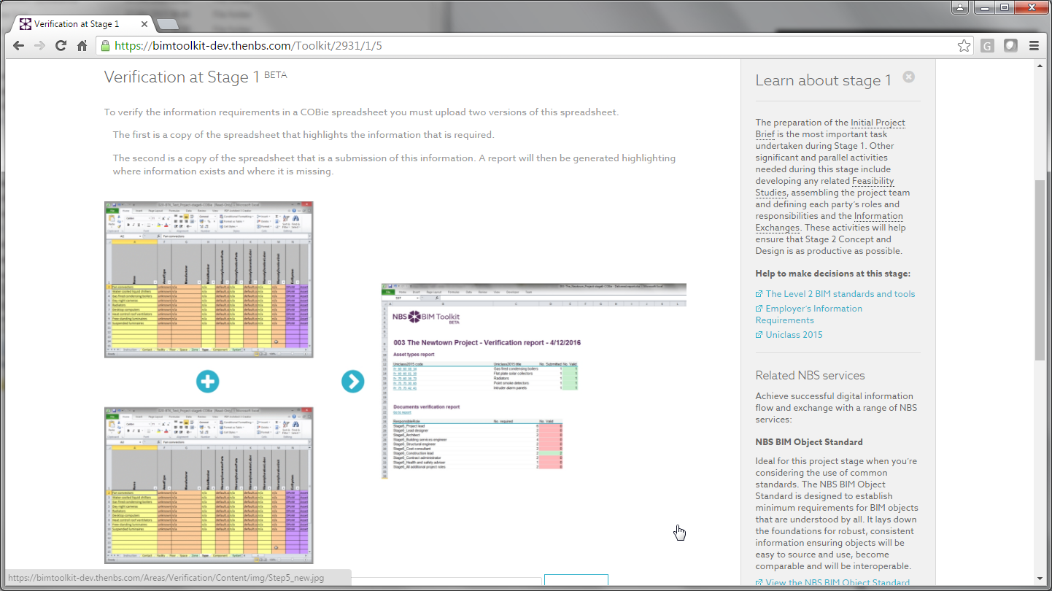
Notes:
Now the production stage begins, concept, developed, technical design and the construction and then hand-over

Slide 12
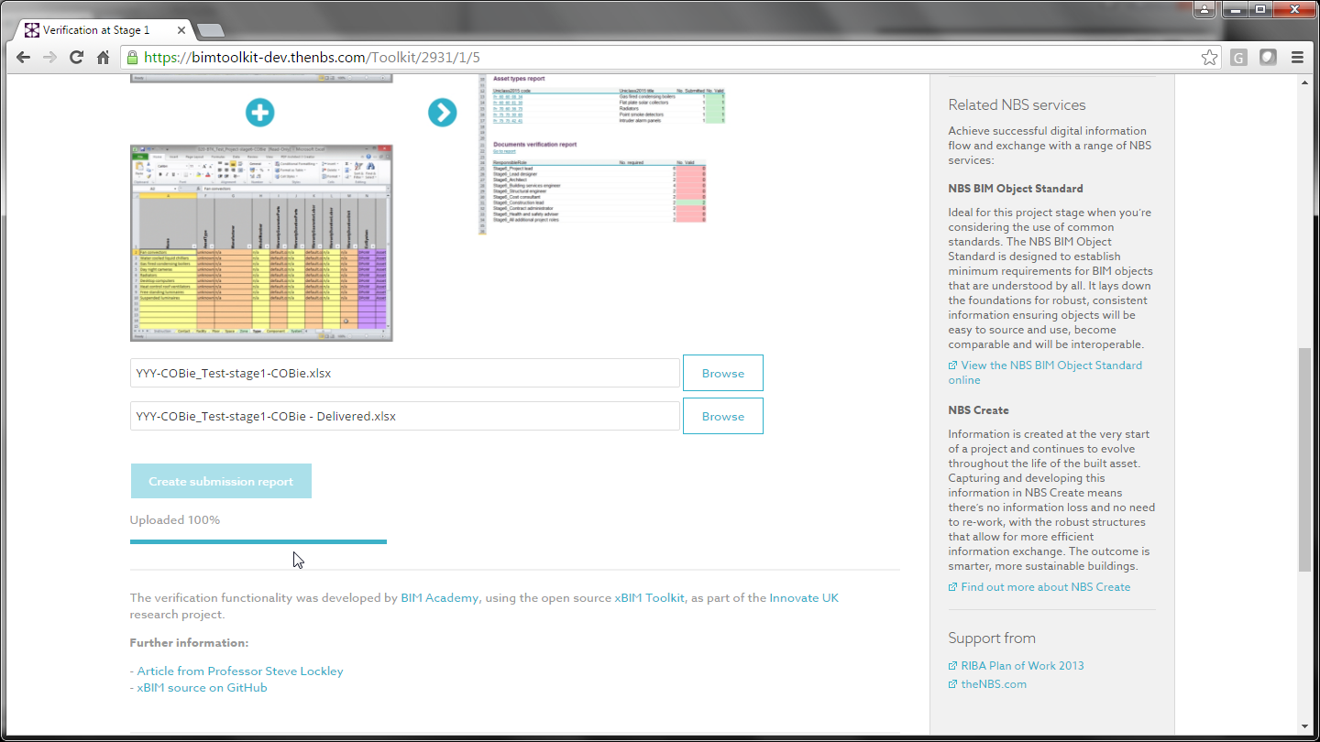
What has been requested may be compared with what has been delivered
Notes:
Now the production stage begins, concept, developed, technical design and the construction and then hand-over

Slide 13
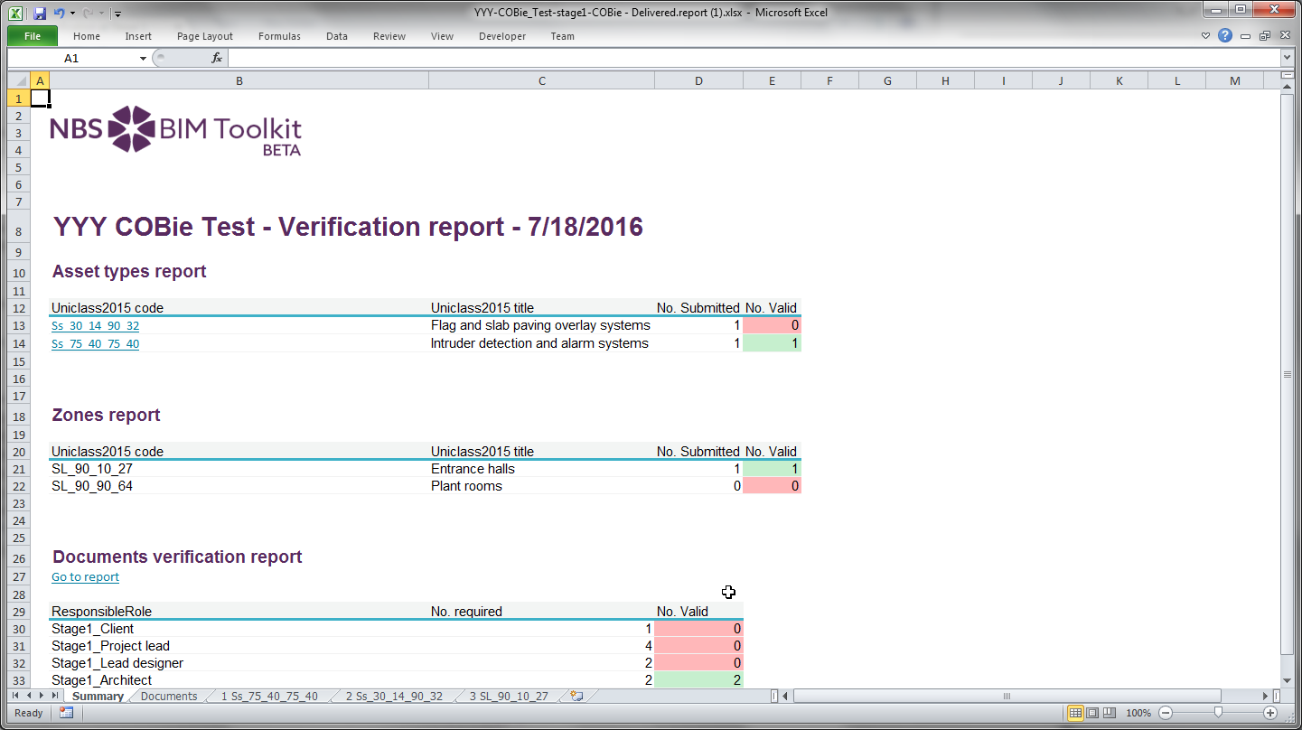
A Red, Amber, Green (RAG) dashboard is provided
Notes:
Now the production stage begins, concept, developed, technical design and the construction and then hand-over

Slide 14
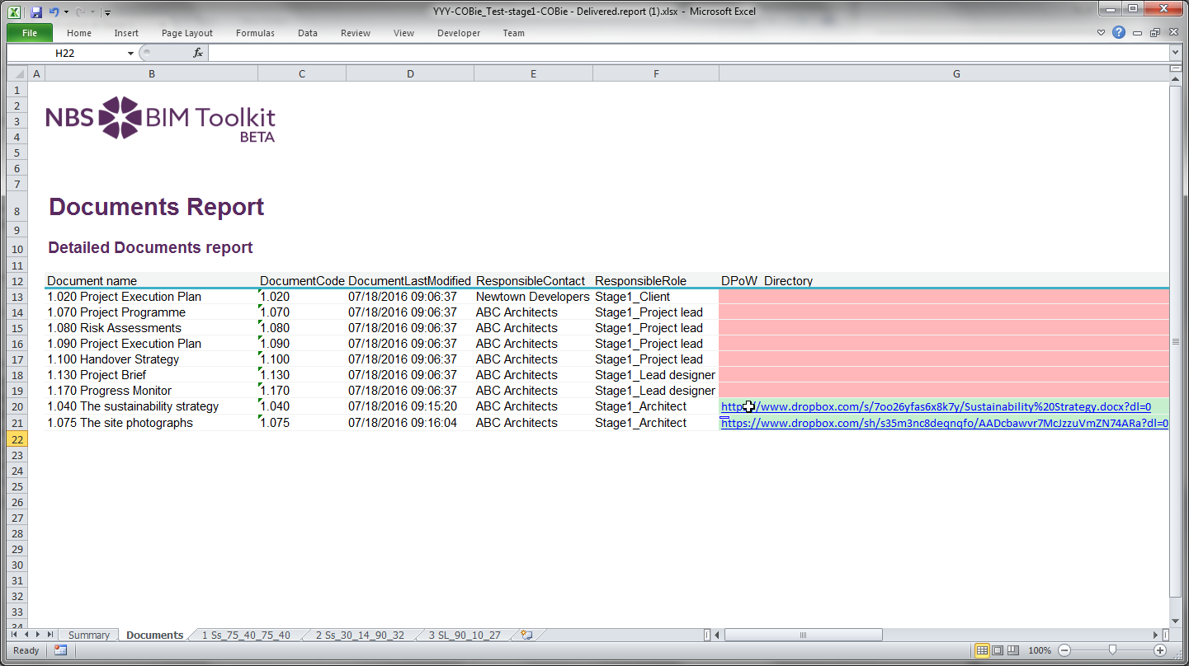
Information provided (and not provided) may be seen
Notes:
Now the production stage begins, concept, developed, technical design and the construction and then hand-over

Slide 15
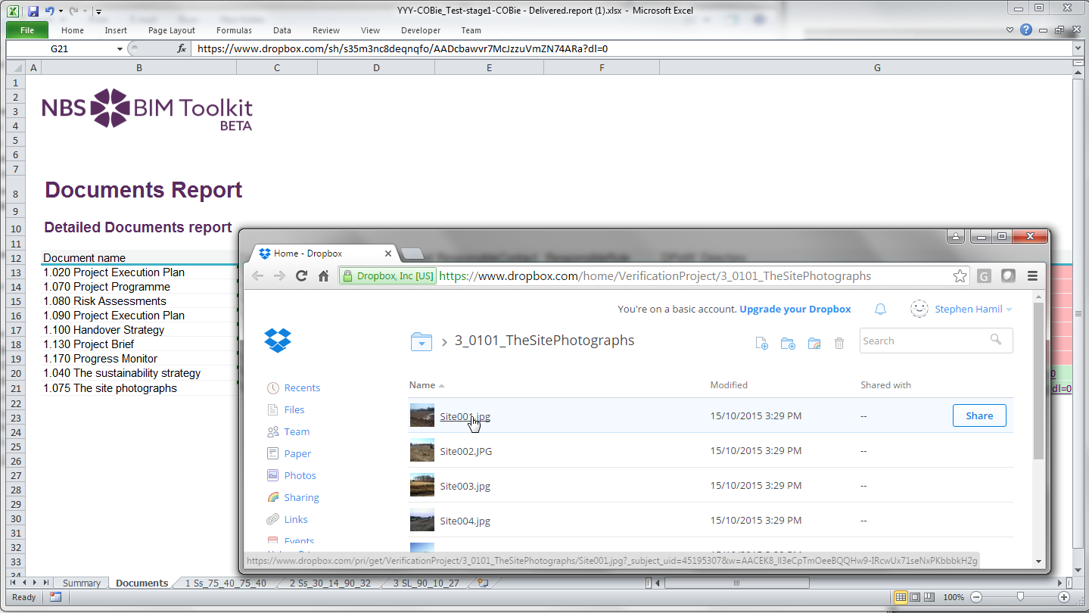
Notes:
Now the production stage begins, concept, developed, technical design and the construction and then hand-over

Slide 16
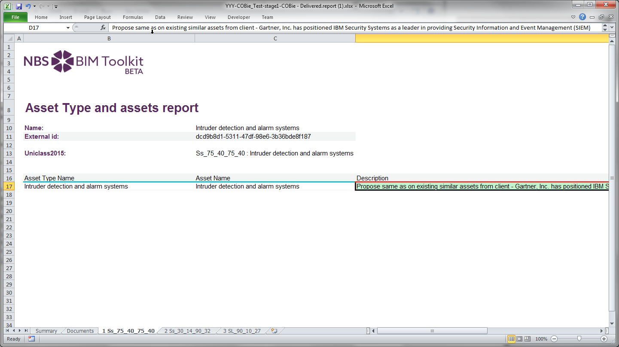
Each type has its own worksheet
Notes:
Now the production stage begins, concept, developed, technical design and the construction and then hand-over

Slide 17
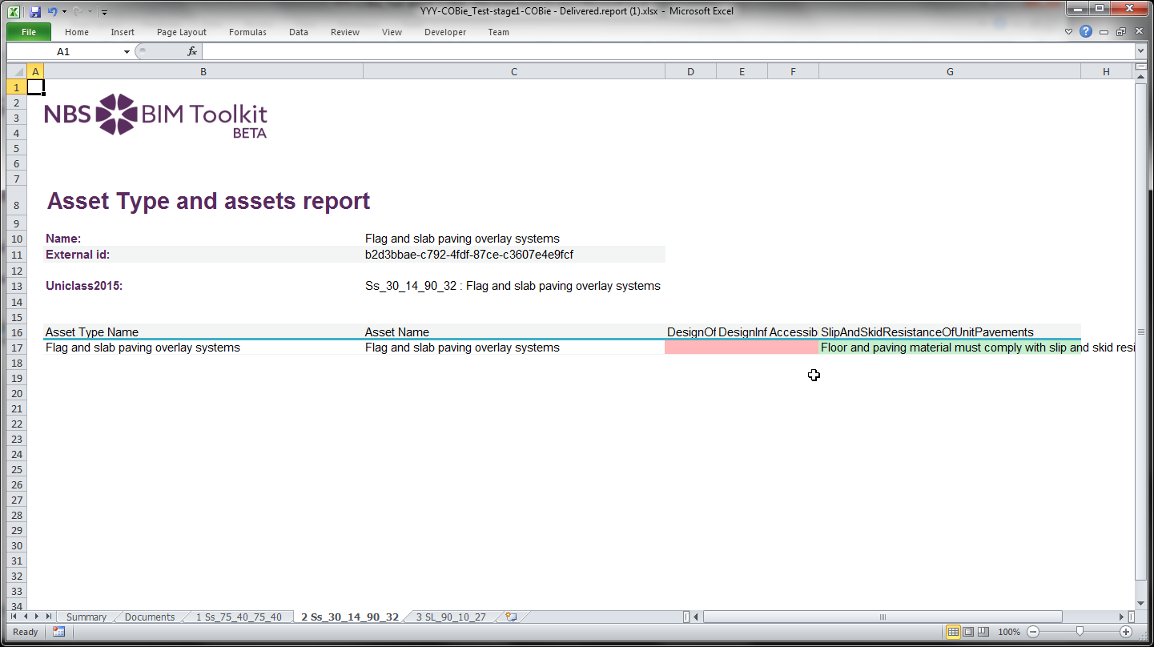
Notes:
Now the production stage begins, concept, developed, technical design and the construction and then hand-over

Slide 18
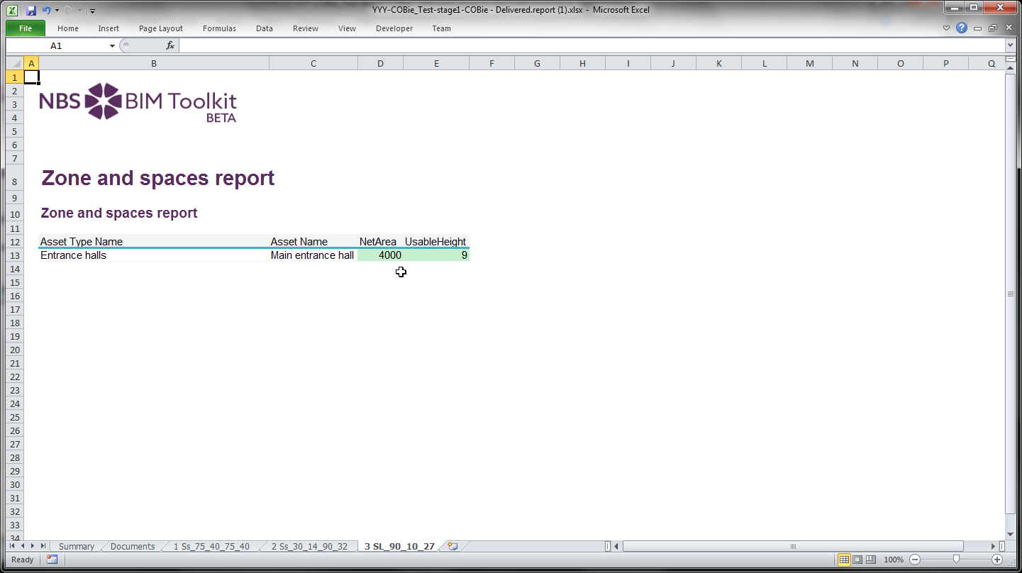
Notes:
Now the production stage begins, concept, developed, technical design and the construction and then hand-over

Slide 19
b. Handover

Slide 20
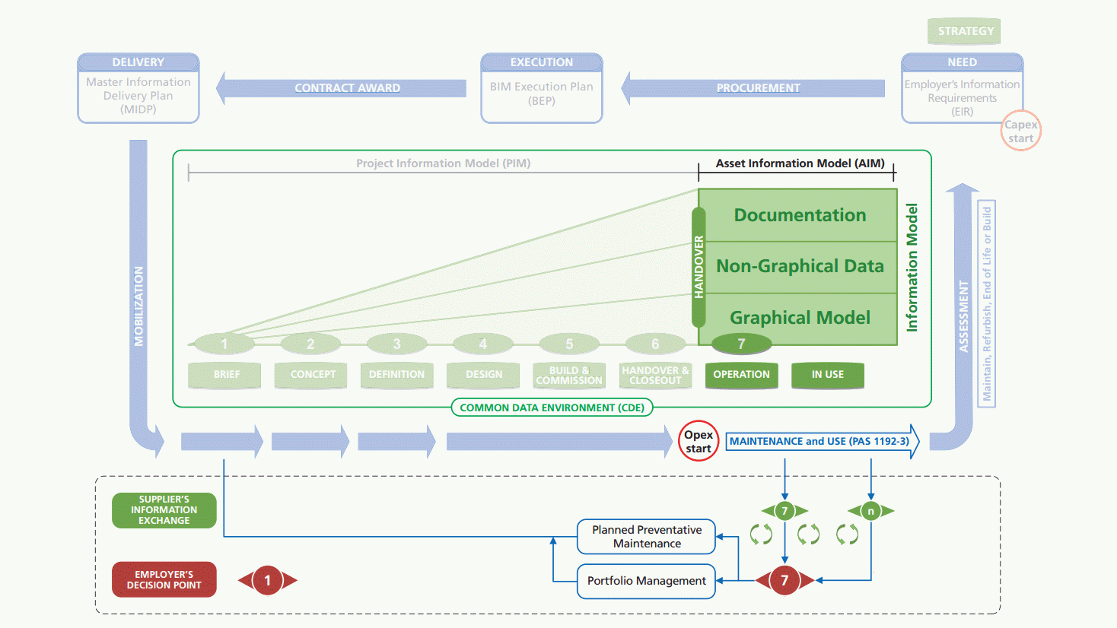

Maintenance and use

Slide 21
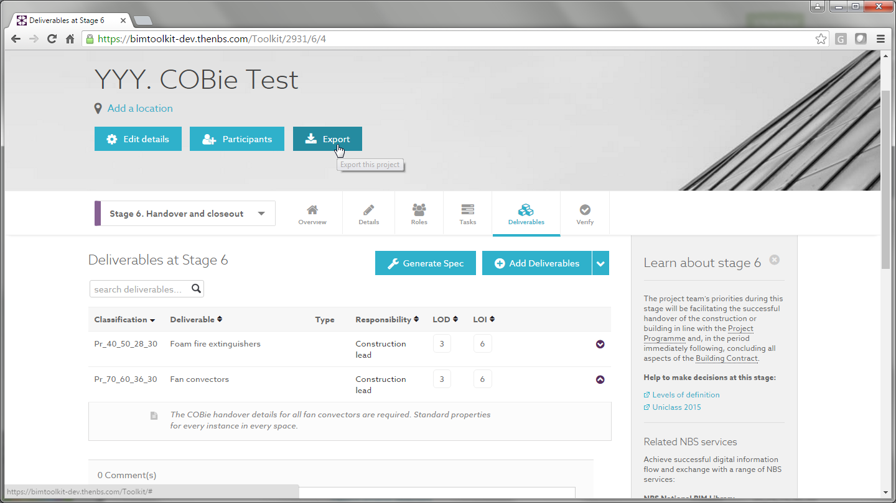
A simple example with two types of item
Notes:
Now the production stage begins, concept, developed, technical design and the construction and then hand-over

Slide 22
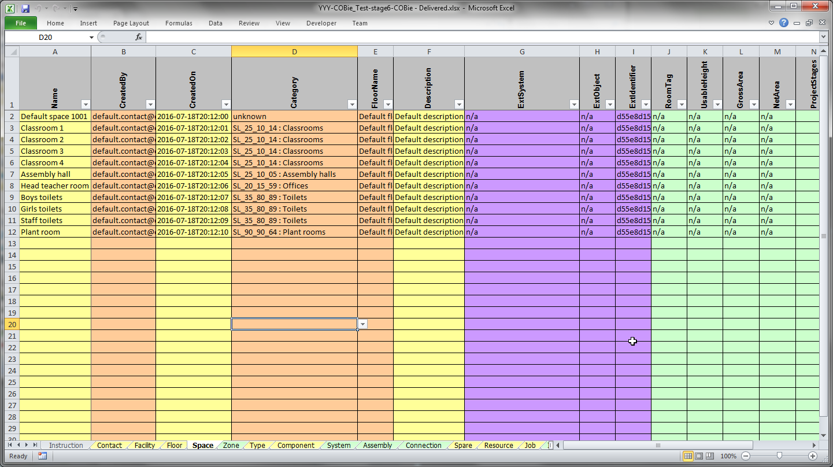
At a later stage of the project, all space instances are known
Notes:
Now the production stage begins, concept, developed, technical design and the construction and then hand-over

Slide 23
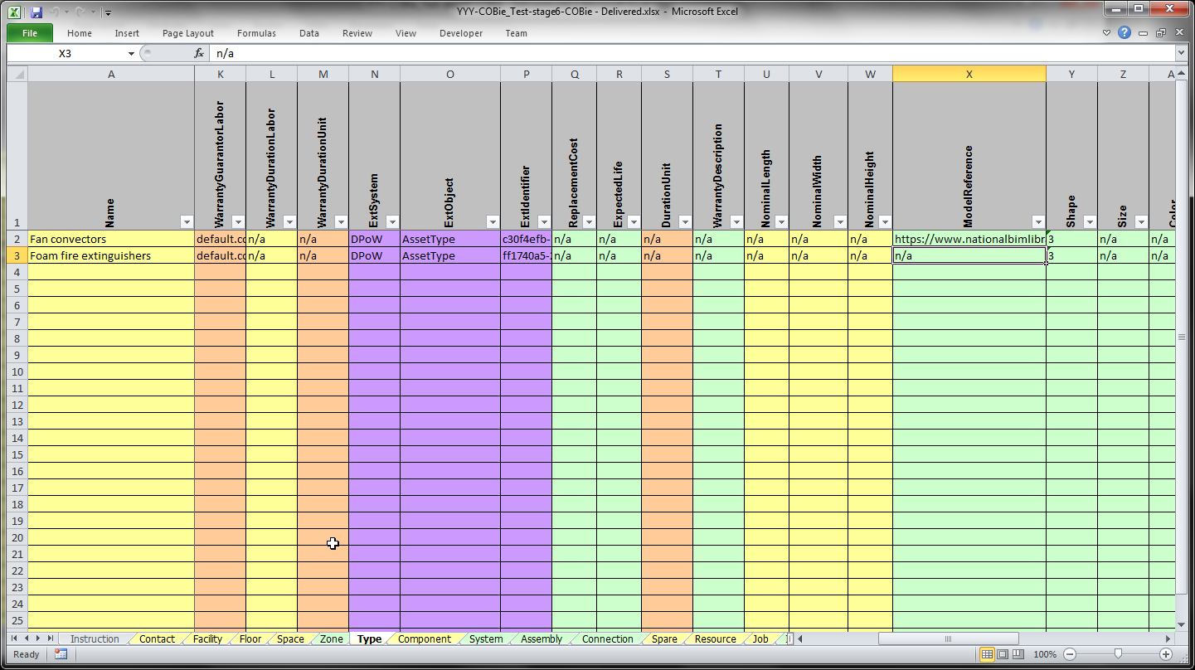
The types of items are listed in the Type worksheet
Notes:
Now the production stage begins, concept, developed, technical design and the construction and then hand-over

Slide 24
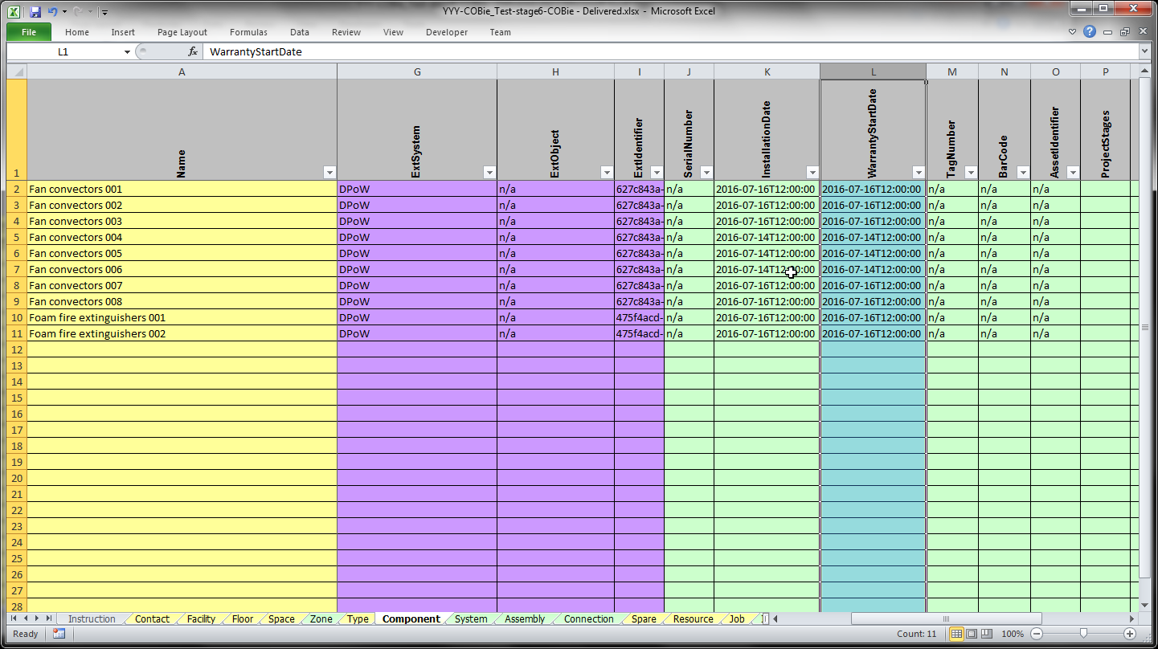
The Component worksheet links the instance of the item by Type and Space
Notes:
Now the production stage begins, concept, developed, technical design and the construction and then hand-over

Slide 25
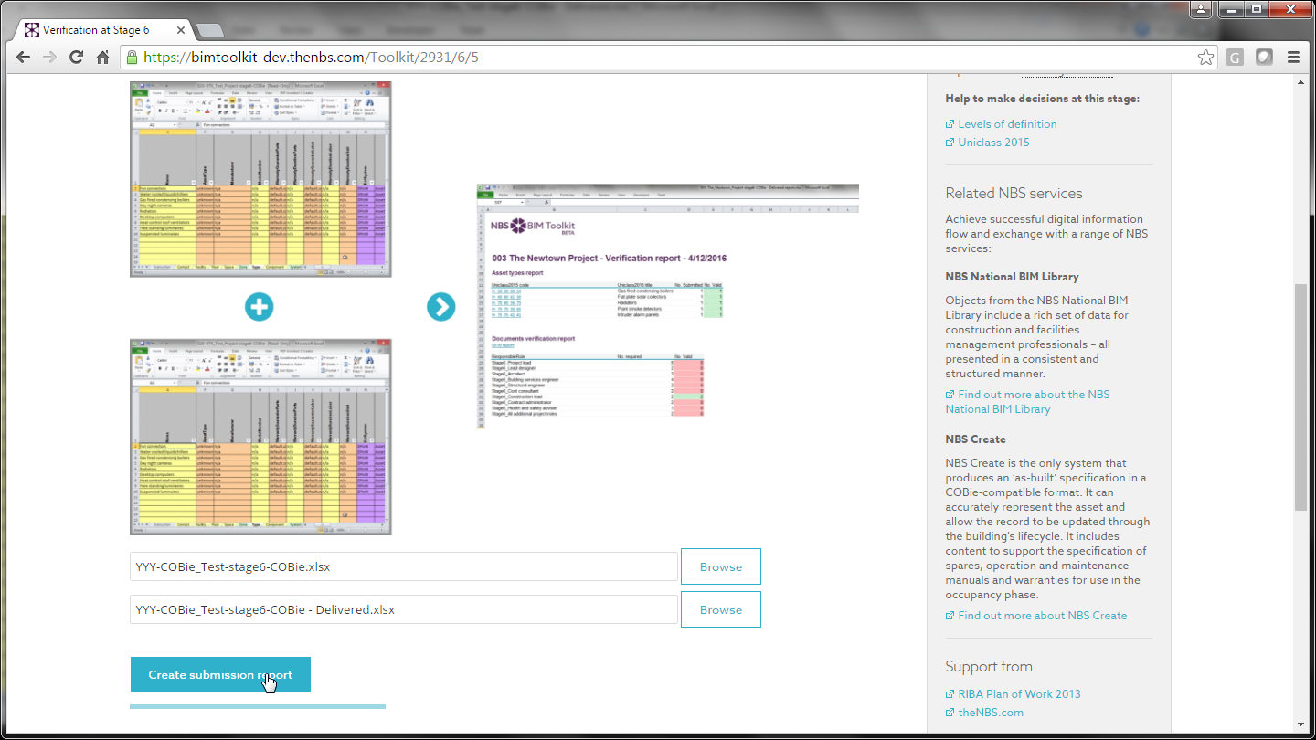
Notes:
Now the production stage begins, concept, developed, technical design and the construction and then hand-over

Slide 26
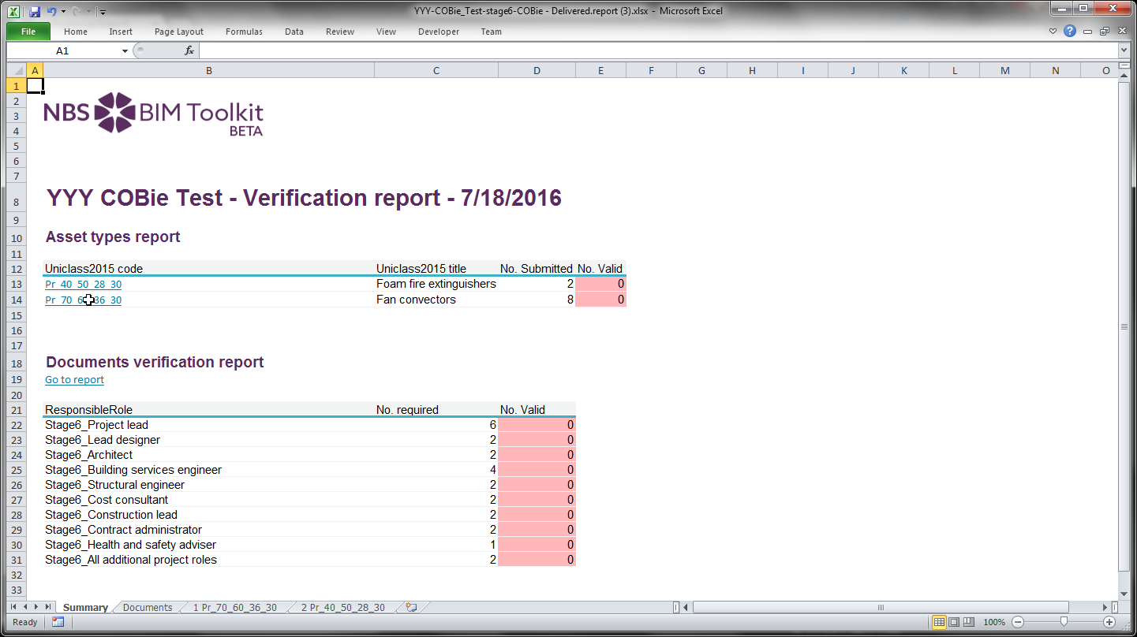
Notes:
Now the production stage begins, concept, developed, technical design and the construction and then hand-over

Slide 27
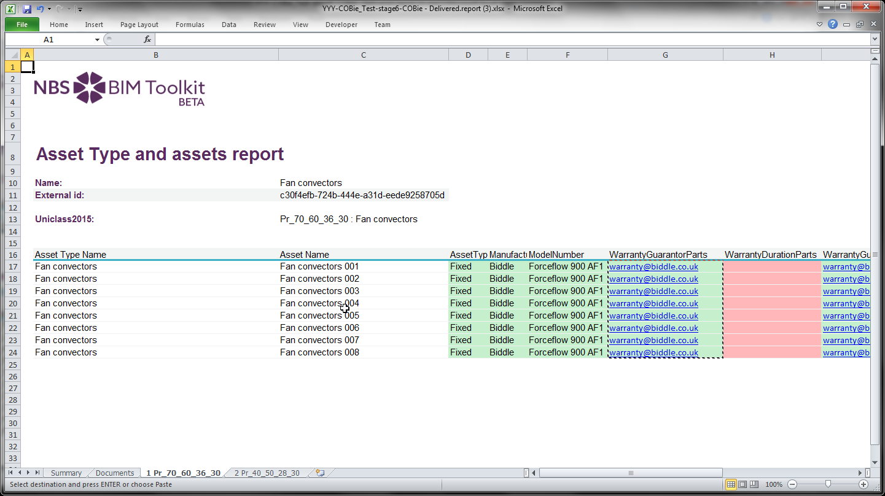
Missing and provided information is clearly shown
Notes:
Now the production stage begins, concept, developed, technical design and the construction and then hand-over

Slide 28
Summary

Slide 29
Summary
Simple COBie compare to go live in next few months
Check for existence of information for SL, Ss, Pr and Documents
Lots more research work and source code from BIM Academy

Slide 30
www.theNBS.com/Toolkit
Questions and discussion…

